Slide 1
HST 306: Rise of Mass Incarceration
Class 13
June 13, 2017

Slide 2
1891 Immigration Act
Created Office of the Superintendent of Immigration (Treasury Department)
Oversaw immigration inspectors at ports of entry
Collected arrival manifests from each incoming ships
Expanded the list of excludable classes
polygamists, persons convicted of crimes of moral turpitude, and those suffering loathsome or contagious diseases

Slide 3
Ellis Island (after Manhattan)
Notes:
The first major port of entry opened in 1892.

Slide 4
Excludable
Additional screening
Contagious diseases
Poor physique
Feeblemindedness
Insanity
Likely to become a public charge
Also,
Anarchist
Criminal record
Low moral character

Slide 5
Change in 1920s
Immigration slowed by laws in 1920s
Inspection process shifts abroad
Ellis = detention center primarily
Red Scare detentions, deportations
1940s and early 1950s → de facto prison
Immigrants
Visitors
Displaced persons
Political dissidents
Refugees
Majority were suspected Communists
After public outcry, Ellis closed in 1954

Slide 6
Angel Island
Notes:
The U.S. Immigration Station is located in Angel Island State Park on Angel Island, the largest island in California's San Francisco Bay.
Estimates suggest that between 1910 and 1940, the station processed up to one million Asian and other immigrants, including 250,000 Chinese and 150,00 Japanese, earning it a reputation as the “Ellis Island of the West”

Slide 7
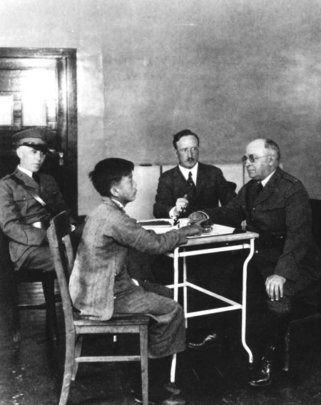
Immigration hearing at Angel Island, 1923. Courtesy of the National Archives and Records Administration.

Slide 8
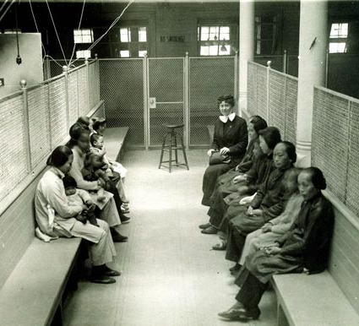
Chinese women and children in a holding room on Angel Island with American missionary Katherine Maurer. California Historical Society, (Neg#: FN-18240).

Slide 9
Angel Island detentions
Only existing image of an occupied dorm (unclear whether in detention barracks or admin building)
Crowded conditions
Wash clothes in bathroom sinks
Required to provide their own soap
Dried clothes by draping over radiators or hanging them on ropes

Slide 10
Detentions (1910-1940)
500,000 people detained
85,000 Japanese
50,000 Chinese
8,000 South Asians
8,000 Russians and Jews
1,000 Koreans
1,000 Filipinos
Different treatment
how they were scrutinized by immigration officials
quality of food they were served
comfortable or overcrowded conditions of housing accommodations
privileges such as visiting rights and exercise time
Immigrants from South Asia had the hardest time getting in
They were primarily Sikhs and single men from the Punjab districts of present-day India and Pakistan who had left their homes to escape British colonialism
highest rejection and deportation rate
In contrast, Japanese immigrants had the shortest stay and the lowest rate of deportation (less than 1 percent) among all immigrants

Slide 11
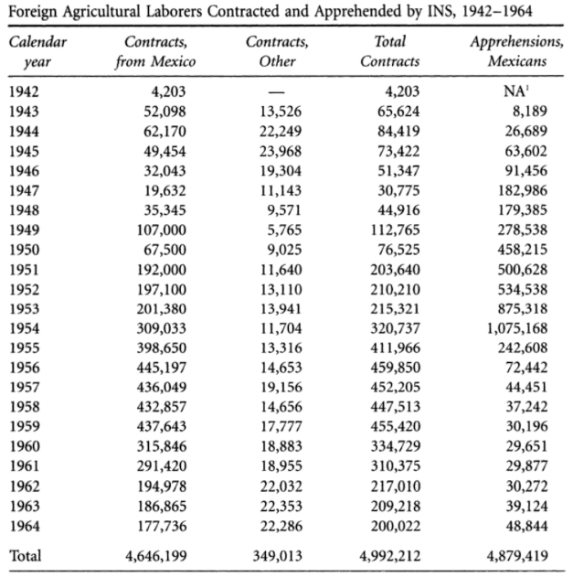
Detention centers fill beyond capacity in the 1950s
Notes:
WWII had created a national security apparatus for policing the border – while new detention centers were waiting to be funded and built, INS officers erected temporary detention centers in barns and fields – apprehensions meant people would have to be housed while awaiting deportation
Local governments along border communities recognized the need of INS so began renting out beds in jails for $1.50 a day – renting jail beds was so financially successful that border communities expanded their jail capacities to house more migrants
1953 – Mexican border patrol

Slide 12
Why 1942?
Bracero (started in August 1942) had sought to fill labor shortages primarily in agricultural fields in the West Coast
President Roosevelt issued Executive Order 9066 in February 1942
Before 1942, Japanese immigrants and Japanese-American citizens held many of the agricultural jobs and were a critical part of the labor force in the West Coast

Slide 13
Japanese Internment
Over 100,000 people were forcibly relocated to internment camps
2/3rds were U.S. citizens
10 such camps (“relocation centers”)
1/2 of those detained in camps were children

Slide 14
Korematsu v. United States (1944)
Fred Korematsu, an American citizen of Japanese descent, refused to leave his home in San Leandro, California.
Korematsu was prosecuted for defying Executive Order 9066.
He was convicted of violating the law and he appealed his case all the way to the U.S. Supreme Court.
The Court upheld Korematsu's conviction in a 6-3 decision.
Korematsu was sent to an internment camp in Topaz, Utah.

Slide 15
Change in Policy (1954)
“we have formulated a new policy – a policy which I am pleased to announce today because I believe you will agree it will make a vast improvement in one phase of your Government’s relations with individuals. It is one more step forward toward humane administration of the Immigration laws… In all but a few cases, those aliens whose admissibility or deportation is under study will no longer be detained. Only those deemed likely to abscond or those whose freedom of movement could be adverse to the national security or the public safety will be detained. All others will be released on conditional parole or bond or supervision, with reasonable restrictions to insure their availability when their presence is required by the Immigration and Naturalization Service.”
~ Herbert Brownell, Jr., Attorney General
Speech delivered in New York, November 11, 1954

